Slide 1
Face Recognition using Principal Component Analysis (PCA), MATLAB
Presented by: Hafsa Farooq

Slide 2
Outline
History
Introduction
Interfacing with other languages
Applications of MATLAB
Face Recognition using Principal Component Analysis

Slide 3
History
Cleve Moler, the chairman of the computer science department at the University of New Mexico, started developing MATLAB in the late 1970s. Later, Jack Little joined with Moler and Steve Bangert, rewrote MATLAB in C and founded MathWorks in 1984 to continue its development.

Slide 4
Introduction
MATLAB is a multi-paradigm numerical computing environment and proprietary programming language developed by MathWorks. MATLAB allows matrix manipulations, plotting of functions and data, implementation of algorithms, creation of user interfaces, and interfacing with programs written in other languages.
Simulink, adds graphical multi-domain simulation and model-based design for dynamic and embedded systems.
Developer(s) | MathWorks
Initial release | 1984
Stable release | R2019b / September 11, 2019
Written in | C/C++, Java
Operating system | Windows, macOS, and Linux
Website | mathworks.com

Slide 5
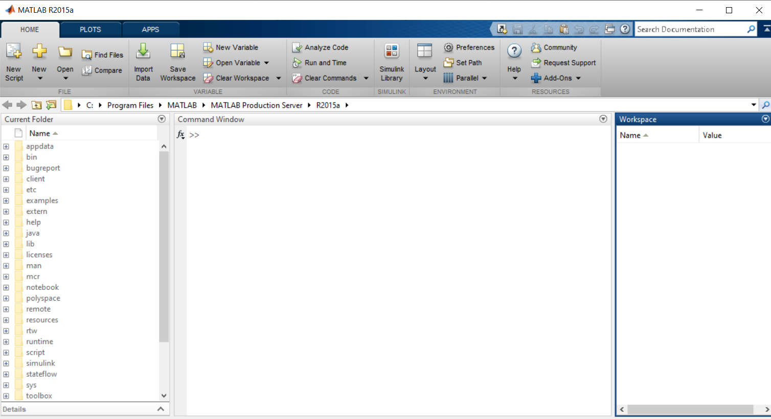
The usage of the MATLAB application involves using the "Command Window" as an interactive mathematical shell or executing text files containing MATLAB code.
The MATLAB is a scripting language, with core functions pre-compiled as mex files.

Slide 6
Interfacing with other languages
It provides functions for integrating MATLAB based algorithms with external applications and languages such as C, Java, .NE, Python and Microsoft Excel.
A wrapper function is used
Libraries also exist to import and export MathML

Slide 7
Application of MATLAB
MATLAB is widely used as a computational tool in science and engineering encompassing the fields of physics, chemistry, math and all engineering streams.
Signal Processing and Communications
Image and Video Processing
Control Systems
Test and Measurement
Computational Finance
Computational Biology

Slide 8
Face Recognition using PCA
Principal component analysis (PCA) is a technique used to emphasize variation and bring out strong patterns in a dataset. It's often used to make data easy to explore and visualize.
PCA is mathematically defined as an orthogonal linear transformation that transforms the data to a new coordinate system such that the greatest variance by some projection of the data comes to lie on the first coordinate (called the first principal component), the second greatest variance on the second coordinate, and so on.
PCA was introduced in 1901 by Karl Pearson

Slide 9
Objective
With several variables, the dispersion matrix may be too large to study and interpret properly. There would be too many pair wise correlations between the variables to consider. Graphical display of data may also not be of help in case the data set is very large. With 12 variables, for example, there will be more than 200 three-dimensional scatter plots to be studied.
To interpret the data in a more meaningful form, it is therefore necessary to reduce the number of variables to a few, interpretable linear combinations of the data. Each linear combination will correspond to a principal component.
PCA defines a new orthogonal coordinate system that optimally describes variance in a single dataset.

Slide 10
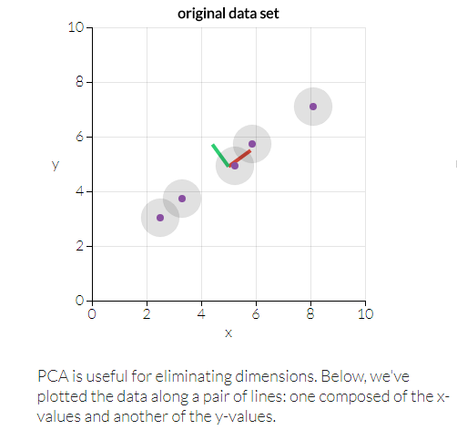

Example of PCA in 2D
Consider a dataset in only two dimensions, like (height, weight). This dataset can be plotted as points in a plane. But if we want to tease out variation, PCA finds a new coordinate system in which every point has a new (x, y) value. The axes don’t exist anything physical; they're combinations of height and weight called "principal components" that are chosen to give one axes lots of variation.
Drag the points around in the following visualization to see PC coordinate system adjusts.

Slide 11
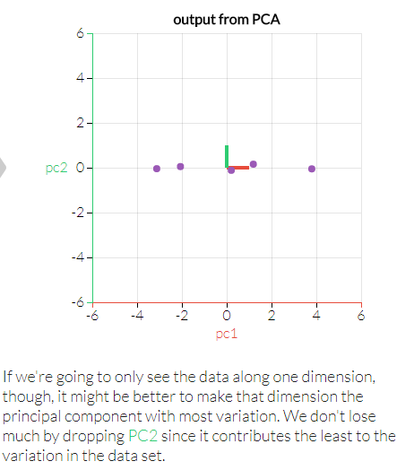

It can also be applied to N- dimensions.

Slide 12
Example of PCA in 3D
With three dimensions, PCA is more useful, because it's hard to see through a cloud of data. In the example below, the original data are plotted in 3D, but you can project the data into 2D through a transformation: rotate the axes to find the best angle. To see the "official" PCA transformation, click the "Show PCA" button. The PCA transformation ensures that the horizontal axis PC1 has the most variation, the vertical axis PC2 the second-most, and a third axis PC3 the least. Obviously, PC3 is the one we can drop.

Slide 13
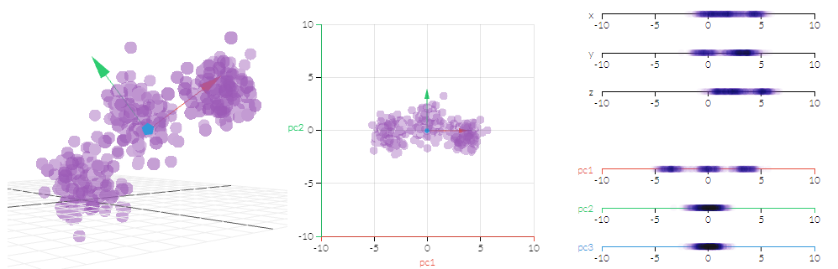

Slide 14
Methodology
Take a dataset of pictures
Convert into gray scale images
Convert the images into a data matrix, (stacking them into a matrix)
Resize the images, based on resolution
Find the averages of the faces(images)
Find the correlation between the rows (group of pictures of one person) of the data matrix
Find the Eigen vectors of maximum magnitudes
Project the eigen vectors to the average face matrix
Testing the new image with the eigen vector space
A new image will be generated having an average face recognition

Slide 15
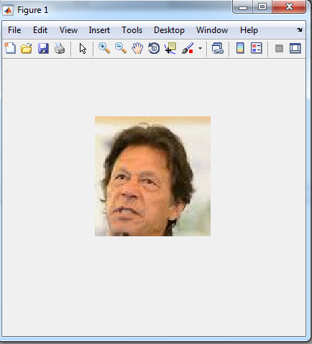
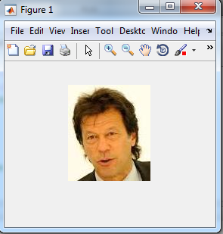
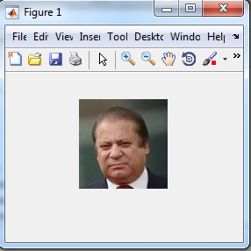
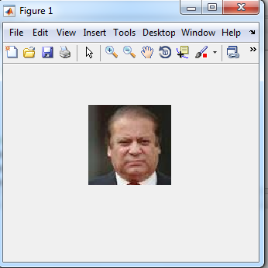

Slide 16
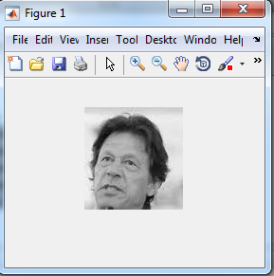
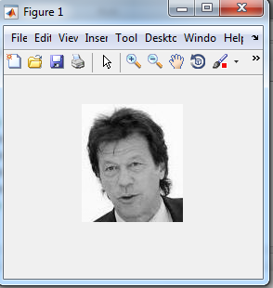
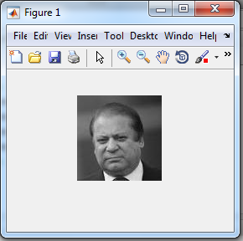
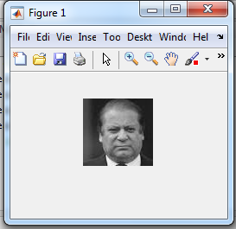

Slide 17
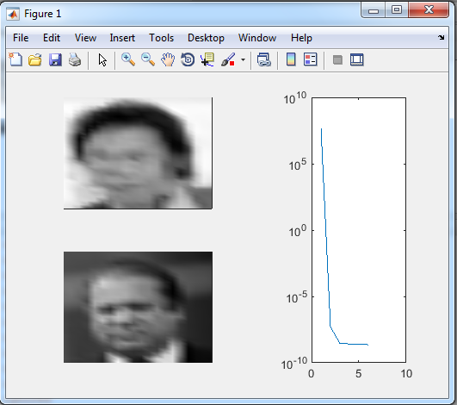

Slide 18
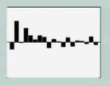
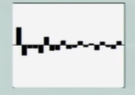
Eigen Values, maximum 20

Slide 19
Any Questions?

Slide 20
Thank you!

